Slide 1



Introduction to
Kalman Filter

Slide 2

Learning Objective
Need of Prediction Algorithm - Example
Basic Introduction to Kalman Filter
Applications of Kalman Filter
How Does Kalman Filter Work
Role of Kalman Filter in Self Driving Car

Slide 3
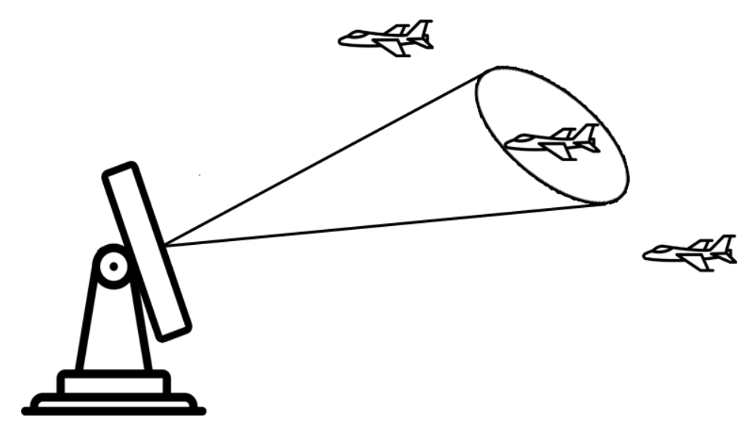
Prediction Algorithm
Radar Tracking Algorithm – tracking radar sends a pencil beam in the direction of target.

Slide 4
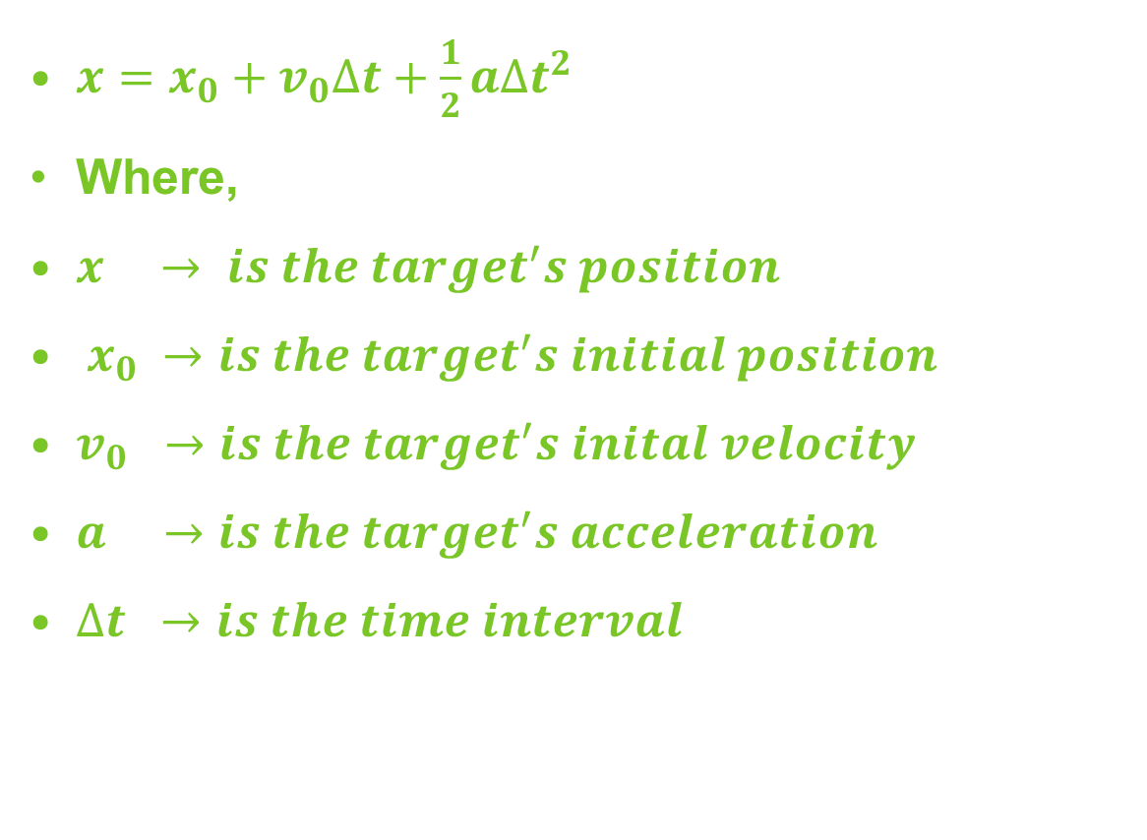
Prediction Algorithm
The future target position can be calculated with using Newton’s Motion Equation.

Slide 5
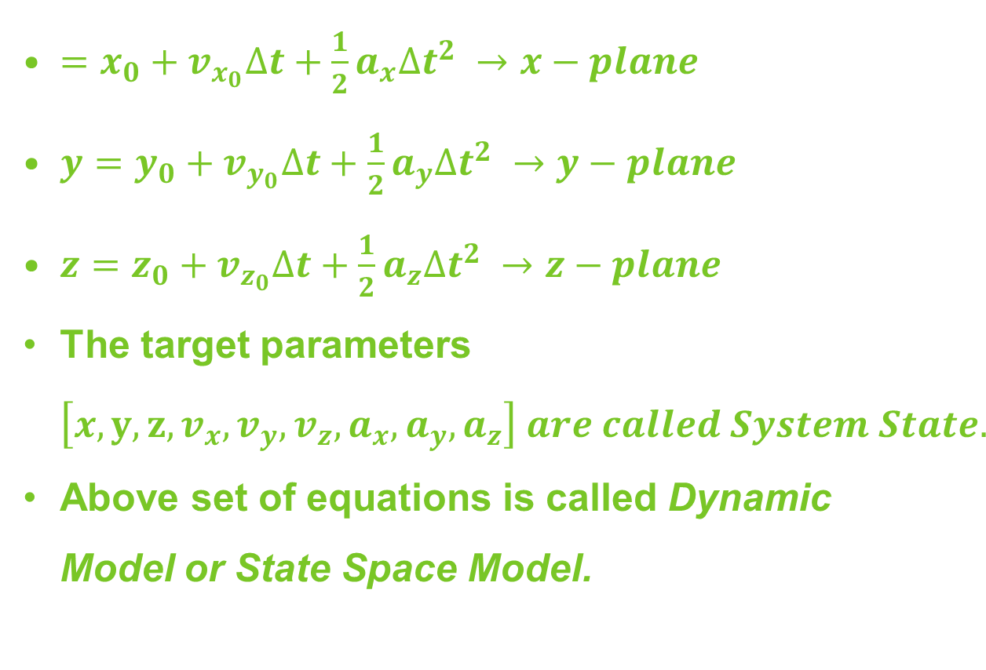
Prediction Algorithm
Newton’s Motion Equation can be written in three dimensions as a system of equations.

Slide 6
Prediction Algorithm
Radar Tracking Algorithm – tracking radar sends a pencil beam in the direction of target.

Slide 7
Radar Measurement
If the current state and the dynamic model are known, then next target can be easily predicted with the help of Newton’s Motion Equation or Dynamic Model.
Radar measurement has random error or uncertainty.
Error depends on Radar Calibration, Beam Width, Magnitude of Return Echo, etc.
The error during measurement is called Measurement Noise.
Dynamic model error is called Process Noise.

Slide 8
Drawback of Newton's Motion Equation
In order to improve this drawback, we need a prediction algorithm that takes into account process uncertainty and measurement uncertainty.
Due to Measurement Noise and Process Noise, the estimated target position can be for away from the real target position.
In this case, the radar might send the track beam in the wrong direction and miss the target.
Solution is Kalman Filter.

Slide 9
Basic Introduction
Named after Rudolf E. Kalman (1930 – 2016)
Kalman Filtering is an algorithm that provides estimates of some unknown variables given the measurement observed over time.
The most important and common estimation algorithm.
Produce estimation of hidden variables based on inaccurate and uncertain measurement.
Provides a prediction of the future system state based on past estimation.
Kalman filters have relatively simple form and require small computational power.

Slide 10
Applications
One of the very first application of Kalman Filter is Apollo Project.
Used to estimate the trajectories of manned spacecraft to the Moon and back.
Common application include,
Guidance and navigation Systems
Computer Vision Systems
Signal Processing Systems

Slide 11
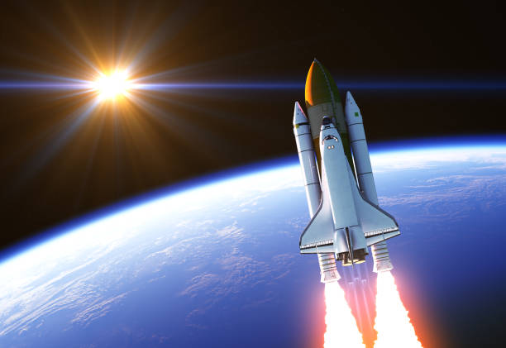
How It Works?
Examples of real time applications of Kalman Filter that how it works.
Spacecraft – example

Slide 12

Spacecraft
Consider this animated spacecraft with combustion fuel.
Liquid Hydrogen

Slide 13

Spacecraft
Failure of Mechanical Parts.
In that situation monitor the internal temperature of spacecraft.

Slide 14
Spacecraft
In this situation Kalman Filter is best option to estimated the Internal Temperature of Spacecraft.
External Temperature (T-ex)
Available for Measurement
Sensor
Internal Temperature (T-in)
Not available for Measurement

Slide 15
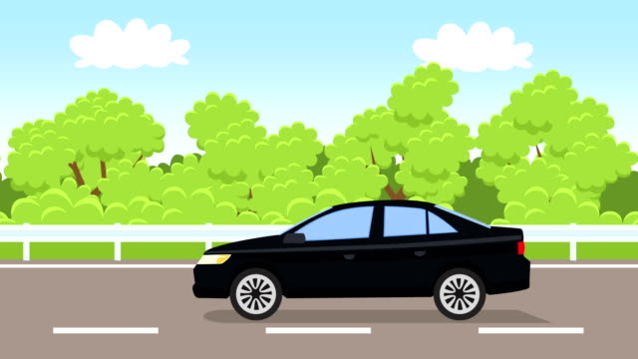
Car Navigation System
Consider you have some guests on bus terminal and you are going to pic them.

Slide 16
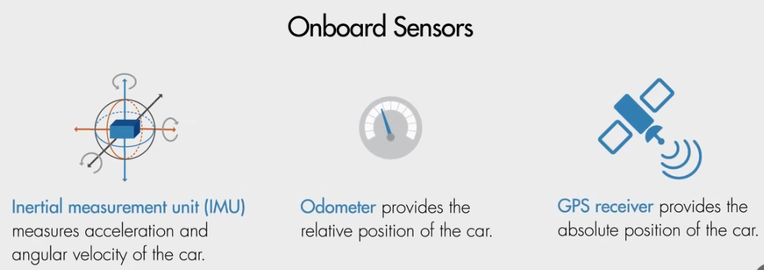
Car Navigation System

Slide 17

Car Navigation System
Weak GPS Signal
Cannot perform navigation
In that case, we must rely on
Onboard Sensors.
IMU, Odometer, and GPS.

Slide 18
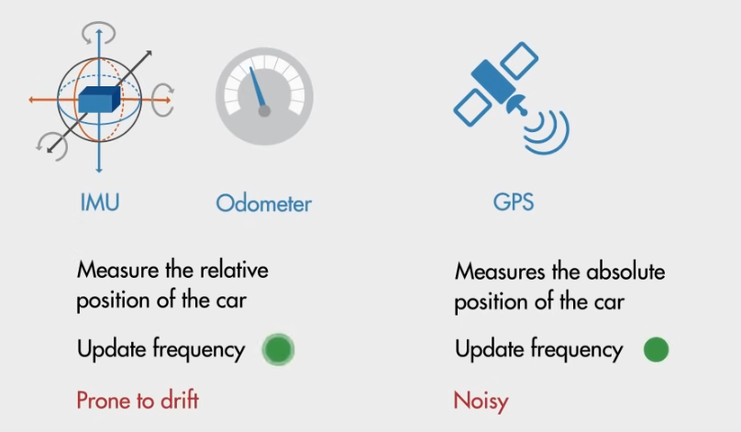
Car Navigation System

Slide 19
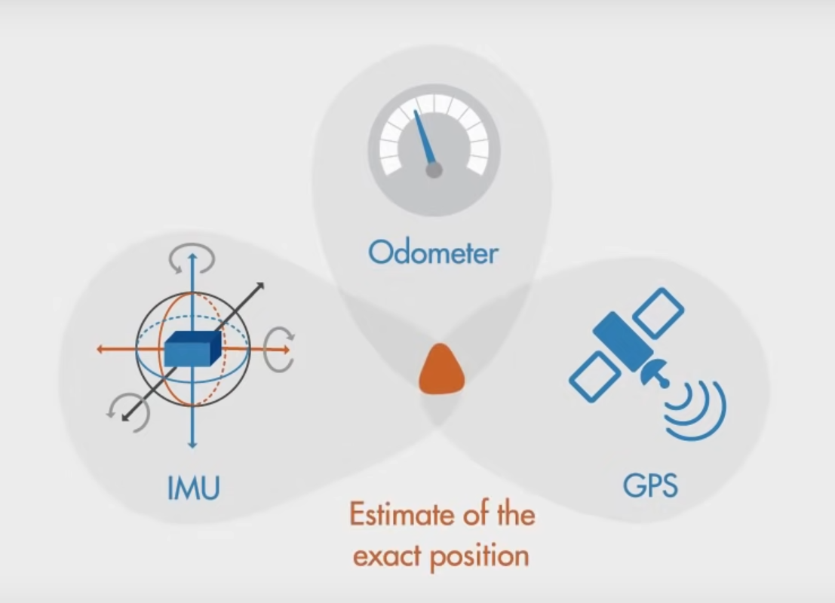
Car Navigation System

Slide 20
Summary
Need of Prediction Algorithm - Example
Basic Introduction to Kalman Filter
Applications of Kalman Filter
How Does Kalman Filter Work
Role of Kalman Filter in Self Driving Car

Slide 21
Thank You

